Slide 1












UCM
CPOTS – 3rd ERASMUS Intensive Program
Introduction to Charged Particle Optics: Theory and Simulation
http://cpots2013.physics.uoc.gr
Dept. of Physics, University of Crete
Aug 15 – 30, 2013
Heraklion, Crete, GREECE

Slide 2
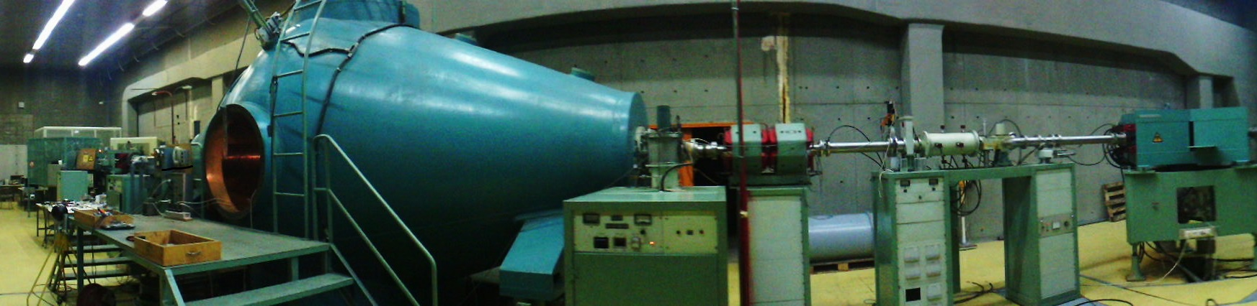
VAN DE GRAAF
ACCELERATOR
Robert J. Van de Graaff (1901-1967)

Slide 3
Contents
Stages of operation
Basic components
The simulation
Lua programming
Problems - Suggestions

Slide 4
Stages of operation
Sputter ion source ,preacceleration (90 keV)
Einzel lens (0-50kV)
Tandem accelerator
  Foil stripper
  Second stage of acceleration
Quadrupoles
Selection magnet
Quadrupoles, switching magnet

Slide 5
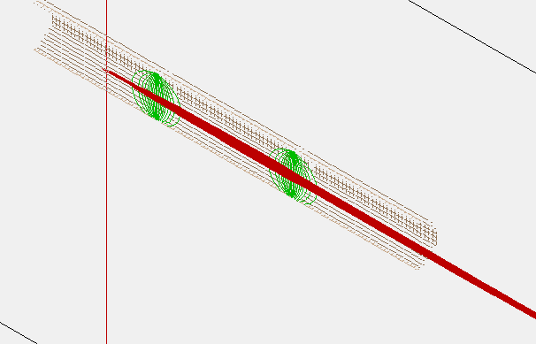
Components
Source: 60 KeVs ,circular distribution ,radius 1
mm, cone direction, half angle of 1⁰
Einzel lens: -34.1kVs

Slide 6
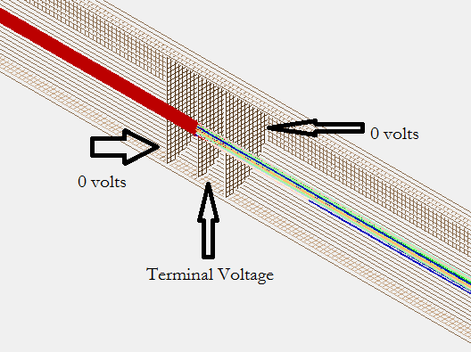
Stages of operation
Tandem accelerator: high accelerating voltages
Carbon foil, many charge states

Slide 7
Stages of operation
Quadrupoles :~450 Mags, many different energies, unable to focus completely the beam

Slide 8
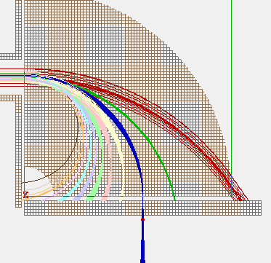
Stages of operation
Selection Magnet: separation of energies -charges

Slide 9
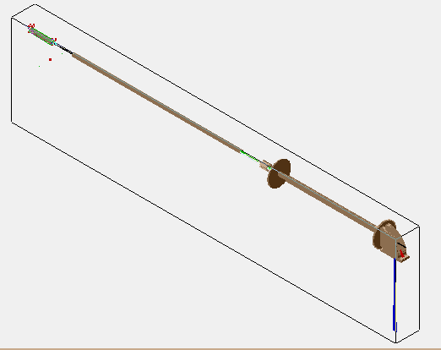
Full Setup

Slide 10
Lua background code
Stripping Procedure
local test1 = TP(x_at_stripping_position_mm,0,0,1,0,0, -- surface
function() -- function called when a particle hits the test plane
new_charge = math.floor(ST.gaussian_rand() * 2 + ion_q_state_at_stripping + 0.5)
end
ion_charge = new_charge
ion_color = new_charge
mark()
local speed, az, el = rect3d_to_polar3d(ion_vx_mm,ion_vy_mm,ion_vz_mm)
local ke = speed_to_ke(speed,ion_mass)
end
)

Slide 11
Lua background code
A further step
Capability of beam selection
function segment.init_p_values()
local terminal_voltage_volts = (req_energy_MeV*1000000- 60000)/(1+req_charge)
if (ion_instance == 7) then adj_elect05 = terminal_voltage_volts end
local velocity = math.sqrt(2*req_energy_MeV*1000000/req_mass)
local magsel=(req_mass*velocity*1.018029323)/(req_charge*0.4)
if (ion_instance == 4) then adj_pole11 = magsel end

Slide 12
Lua background code
A further step
local velocity = math.sqrt(2*req_energy_MeV*1000000/req_mass)
local magsel=(req_mass*velocity*1.018029323)/(req_charge*0.4)
if (ion_instance == 4) then
adj_pole11 = magsel
end

Slide 13
Lua background code
A further step
Final Adjustment – The Quadrapoles focusing
Selective usage
Recursive Code
Monte Carlo type approach
ΔV=V*sqrt(particles)

Slide 14
Problems - Suggestions
Inexplicable errors in KE
Heavy Data Load – Large files
Further adding of parts
Quicker Algorithms

Slide 15
Thank you for listening!
Any questions?

