Slide 1
Elias Papavasiliou Varvara Lagaki

Slide 2
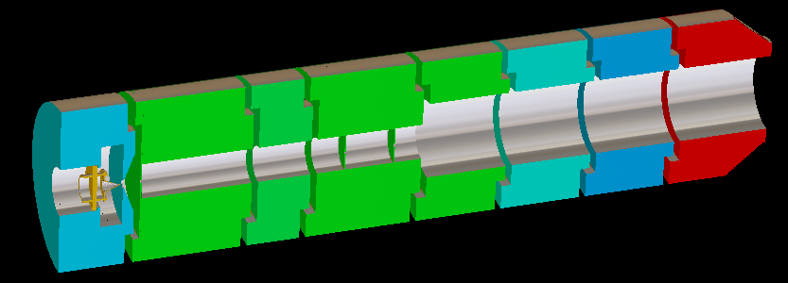
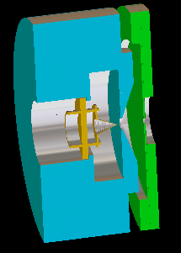
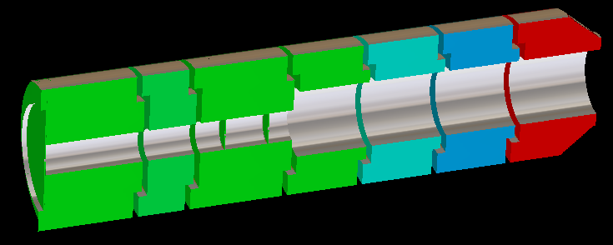
The electron gun
System: 1 source & 7 electrodes

Slide 3
Goal
• Produce a beam of a specific diameter
We have to adjust the voltages…

Slide 4
Adjusting the Voltages
A work which is:
Repetitious
Boring
Long (many voltages)
Ideal for a computer!

Slide 5
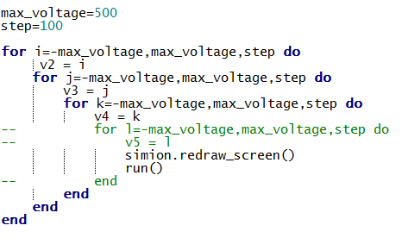
4 Steps:
1) Loop through the voltages

Slide 6
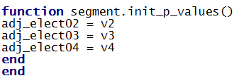
4 Steps:
2) Adjust electrode values

Slide 7
4 Steps:
3) Record the y coordinate for every ion

Slide 8
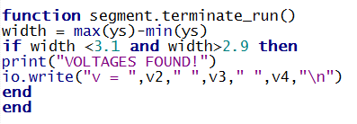
4 Steps:
4) Calculate width and save voltages

Slide 9
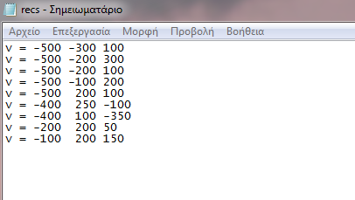
And after 10 minutes…

Slide 10
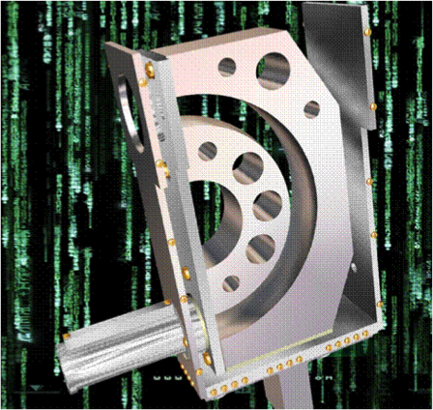
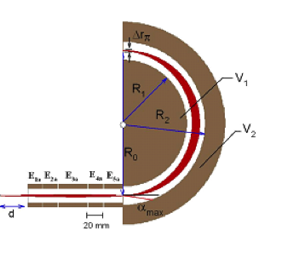
HDA & Input Lenses
Hemispherical deflector
analyzer (HDA) combined with
5 cylindrical input-lens-system
Ro=100mm
R1=87.5mm
R2=112.5mm

Slide 11
Goal
Find a focused beam with the minimum energy to pass through the HDA
Observe the position of focal point by changing only the voltages of the input lenses (kinetic energy and Vin,Vout=constant)
Try to achieve focused beam at 20 eV, 30 eV and 40 eV
Check the energy filtering and determine resolution of the system for the chosen energy

Slide 12
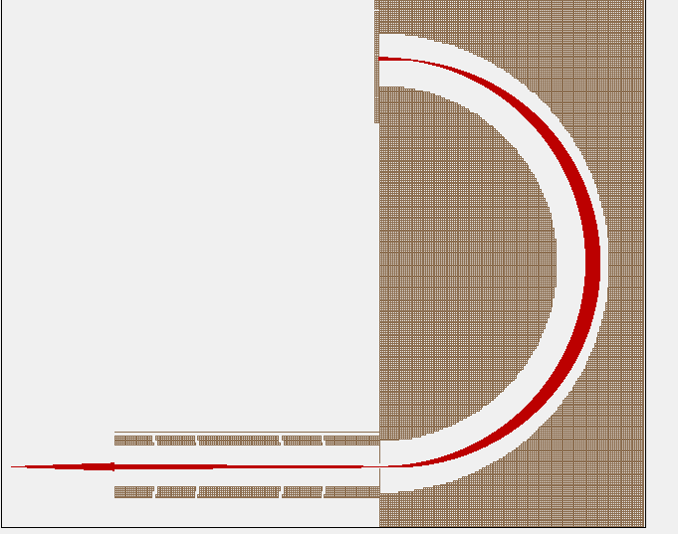
Lowest energy
KE=10 eV
Vout = -2.22 V
VOLTAGES OF THE LENSES
V1 | 0 V
V2 | 30 V
V3 | 70 V
V4 | 20 V
V5 | -4.527 V
Δr=2mm
Vin = 2.86 V
V1 V2 V3 V4 V5

Slide 13
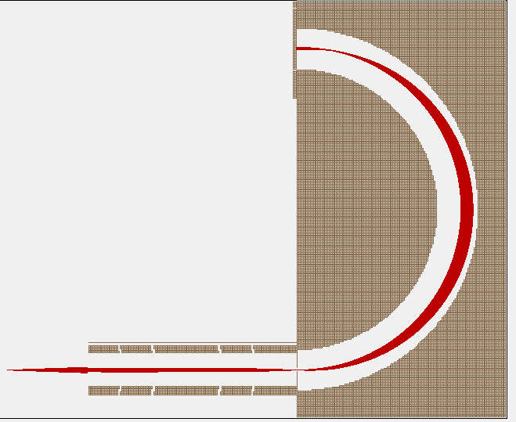
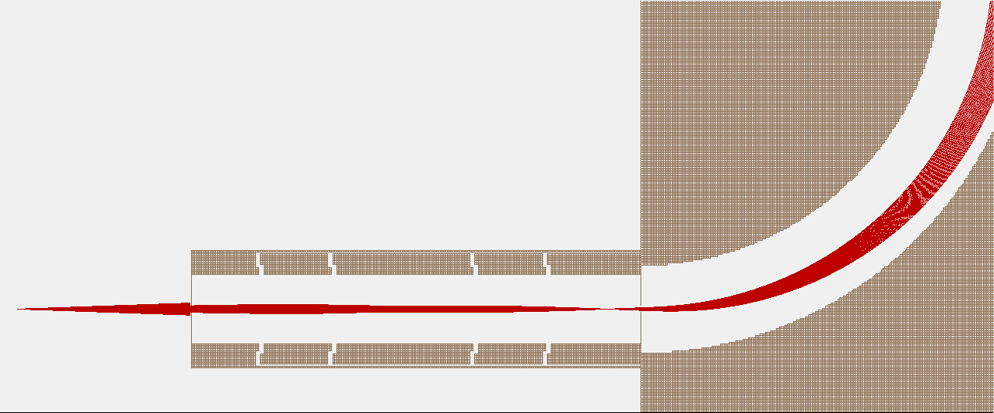
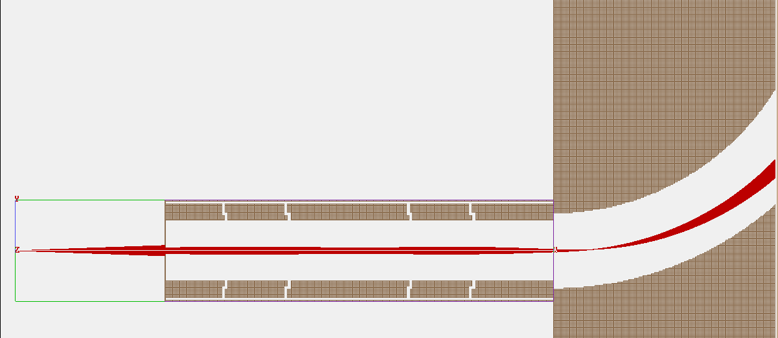
Position of focal point
KE=50 eV
VOUT
CONSTANT
VIN= -11.42 V
VOUT= -26.66 V
V1=0 V
V5= -20 V
VIN
V1 V2 V3 V4 V5
KE=50 eV
KE=50 eV
VIN
VIN
V1 V2 V3 V4 V5
V1 V2 V3 V4 V5
VOUT
VOUT

Slide 14
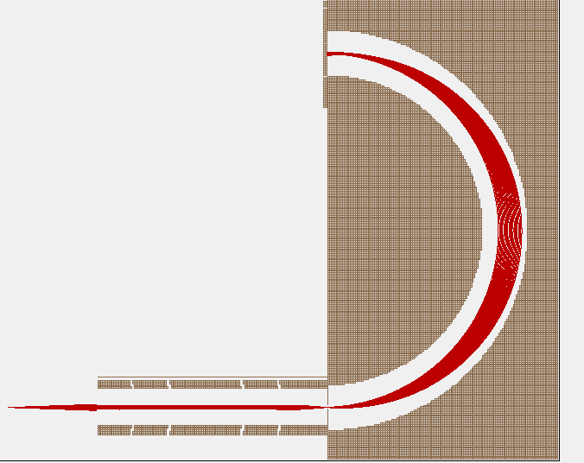
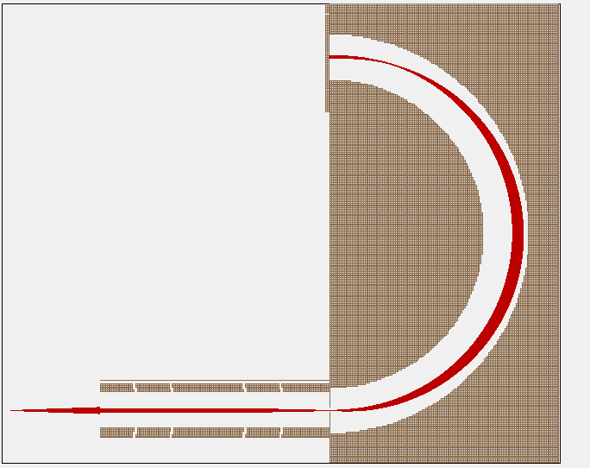
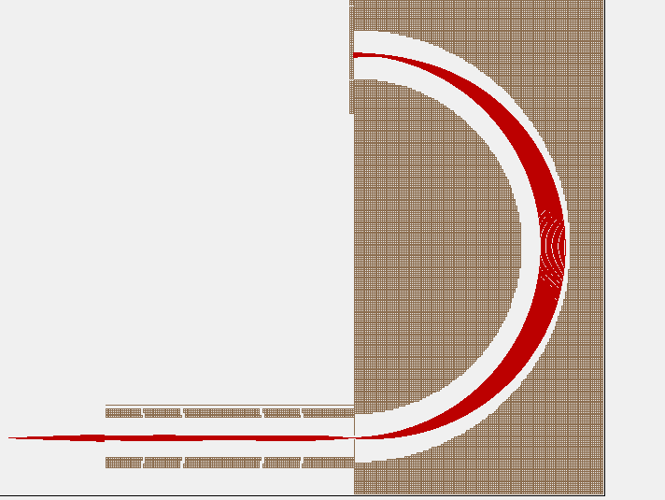
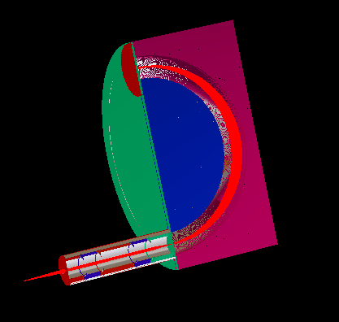
Focusing at 20eV, 30eV and 40eV
KE=20 eV
Vout=5.75eV
KE=30 eV
Vout=-16.77eV
Vin=-4.44eV
Vin=-22eV
V1 V2 V3 V4 V5
V1 V2 V3 V4 V5
KE=40 eV
Vout=-2.1eV
SIMION
3D
Vin=-25eV
V1 V2 V3 V4 V5

Slide 15
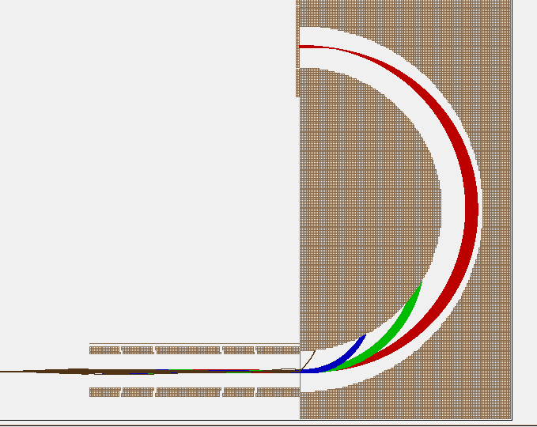
Energy filtering and resolution
VOLTAGES OF LENSES
V1 | 0
V2 | 30
V3 | 245
V4 | 30
V5 | -20
Vout = -26.66 V
KE=50 eV (red)
KE=40 eV (green)
KE=30 eV (blue)
KE=30 eV (black)
Vin = -11.4 2V
V1 V2 V3 V4 V5
Energy resolution for 50 eV :

