Slide 1
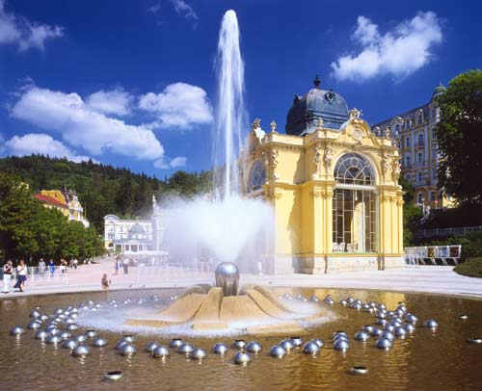
Fountain Spectrometer
Alexander Koukras
Gyula Nagy
Miguel Fernández

Slide 2
Topics
Geometry
Calibration
Transmission
Focusing properties
Resolution
Conclusions

Slide 3
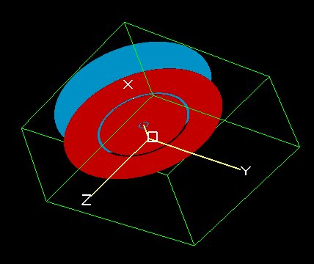
Geometry
Just PPA with 2π cylindrical symmetry (rotating around x axis)
Advantage compared to PPA:
Greater acceptance: more solid angle (2π symmetry)

Slide 4
Calibration
Linear relation between E₀ and V_{d}
Here, q=-1 (e) so
For 45º
Relation V_{d}, E₀ :
Using LUA

Slide 5
Calibration (45º & 30º)
Slope →
Formula →
Slope →

Slide 6
Transmission
T(%) =
For a fixed KE of particles and its corresponding Vd (calibration)
Fly particles slightly different angles →
measure #particles enter, #particles pass through
45º → T= 98.5%
30º → T= 20% !!!
Wider exit slit + 3rd plate (only for 30º)

Slide 7
Transmission (3 plates)
Now: T = 92%
f does not change
3rd plate not to lose resolution

Slide 8
Focusing properties
For 45º → 1st order focusing, focus inside
For 30º → 2nd order focusing, focus outside
Trace width:
 | Simion | Theoretical
30º | 0.2 | 0.03
45º | 2 | 1.3

Slide 9
Resolution
Lua program to scan energy, measure the E_{min} and E_{max} that leave the exit slit, and calculate R
The lower R → the better
 | R
45 º | 1.8 %
30 º | 1%

Slide 10
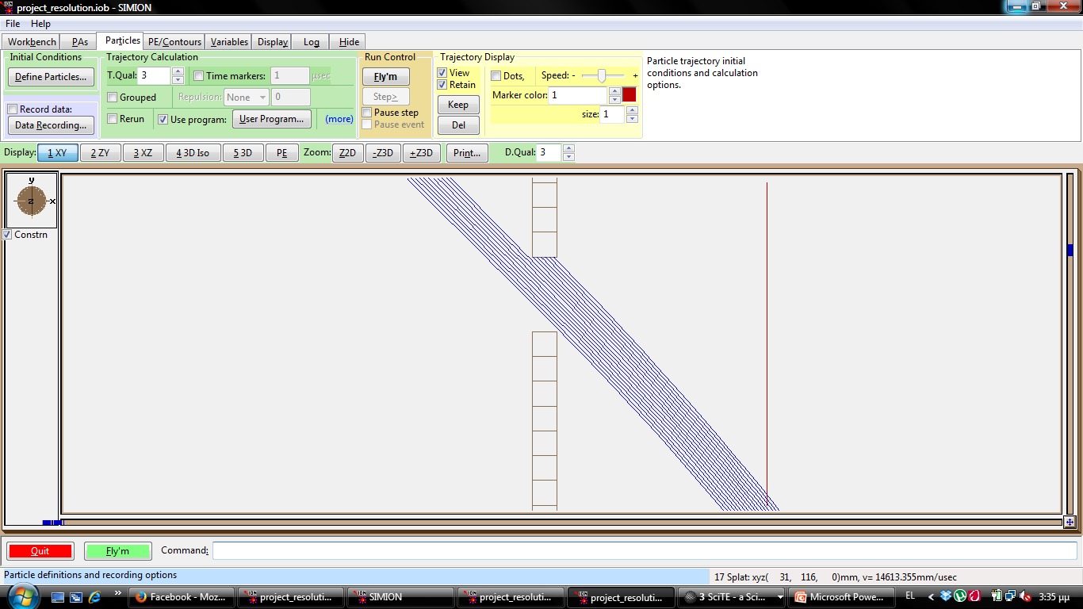
Resolution
Compare 45º with theory:
 | Simion | Formula
45° | 1.8% | 3%

Slide 11
Resolution
Independent of energy
30º has better resolution for same geometry
For 30º, R does not change with 3rd plate + wider exit slit

Slide 12
Conclusions
Better resolution for 30º
Better focusing for 30º
Lower transmission for 30º
Solution: 3rd electrode + wider exit slit

Slide 13
All information
fountainspectrometer.blogspot.com
QR Code

Slide 14
Thanks for your attention
Thanks to our advisors:
Manolis Benis
Pilar Garcés
And all other CPOTS teachers

