Slide 1
UCM
CPOTS – 3rd ERASMUS Intensive Program Introduction to Charged Particle Optics: Theory and Simulation
http://cpots2013.physics.uoc.gr
Dept. of Physics, University of Crete
Aug 15 – 30, 2013
Heraklion, Crete, GREECE
CPOTS 2013: 3rd ERASMUS IP on Charge Particle Optics – Theory and Simulation
Dept. of Physics, University of Crete, Heraklion, GREECE
Project Coordinator: Prof. Theo Zouros (tzouros@physics.uoc.gr)

Slide 2
CPOTS 2013
SIMION Student Group Projects
DETECTOR
Isabella FLOSS (TUW)
Abdullah KEPCEOĞLU (SU)
Angelo VALENTINO (UoI)
Supervisor: Christoph LEMELL (TUW)

Slide 3
Outline
Μοtivation
Material and Methods
Results
Conclusions

Slide 4
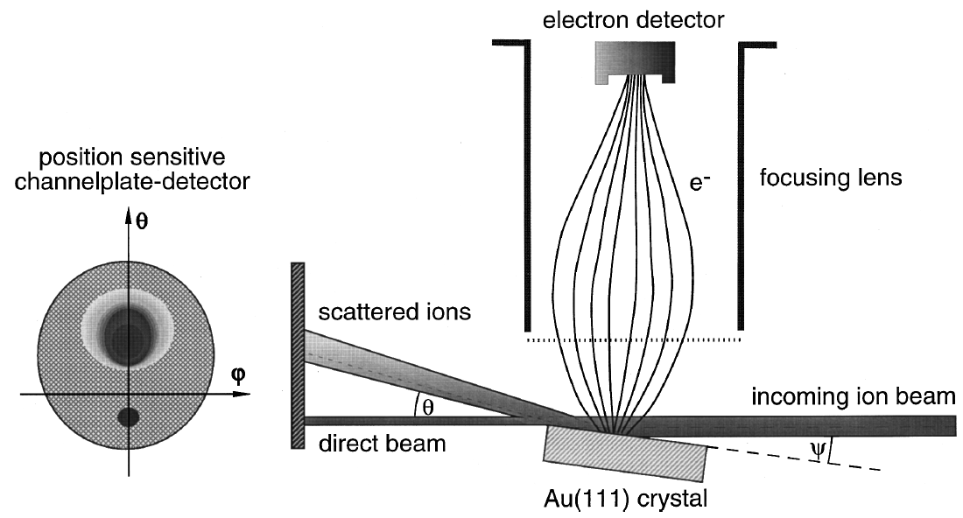
Motivation
detector efficiency?
Lecture 1.3 CL
C. Lemell et al., Rev. Sci. Instrum. 70, 1653 (1999)
Notes:
-particle-induced electron emission
-coincidence measurements of slow singly and multiply charged ion-induced electron emission from a clean monocrystalline gold surface at grazing incidence of projectile ions
-detection efficiency?
-energy of released electrons?
-dependence on rotation angle?
-beam profile?
-starting conditions of electrons: angular and energy distributions
In particular, ion-induced electron emission from solid surfaces is of considerable principal and practical interest in modern surface physics and analytics, and also for various plasma based applications.

Slide 5
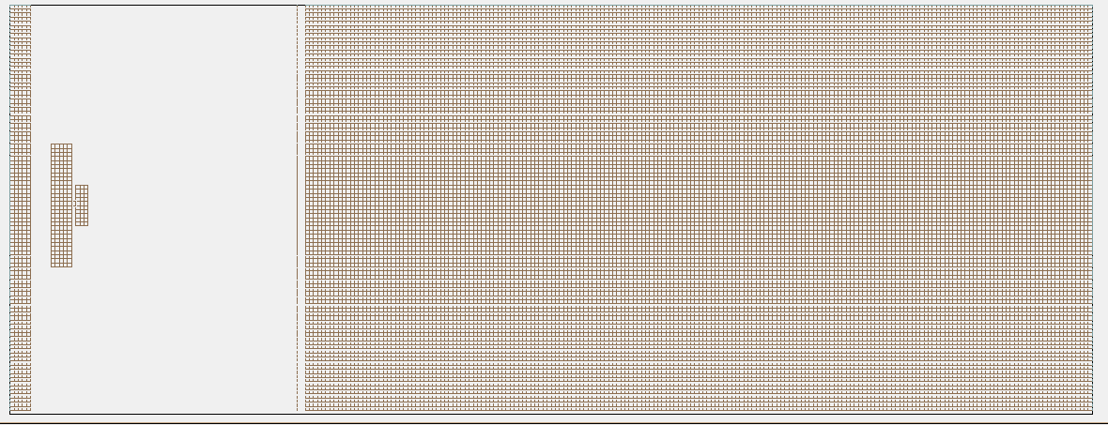
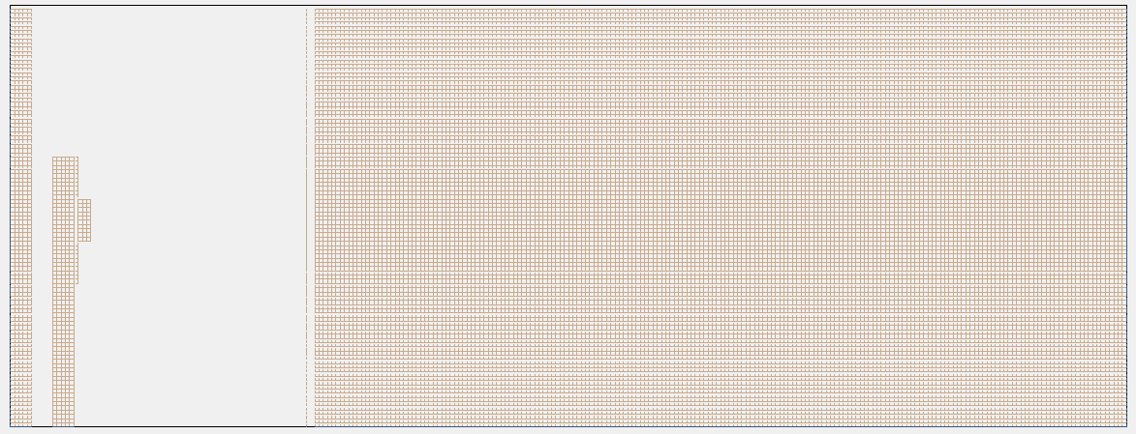
Material and Methods
Detector Geometry
3D ISO
3D
XY
ZY
XZ
Notes:
+A target
+A transparent electrode
+A detector

Slide 6
Material and Methods
Focusing & collecting electrons
XY

Slide 7
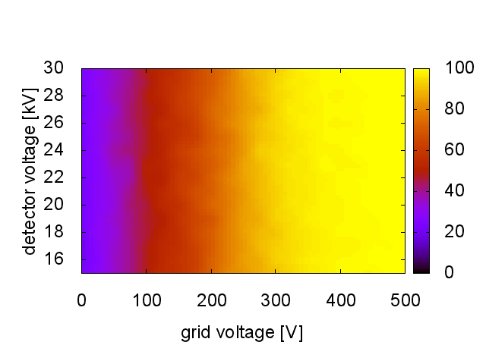
Results
$Ψ=0°$
K.E. = 50 eV

Slide 8
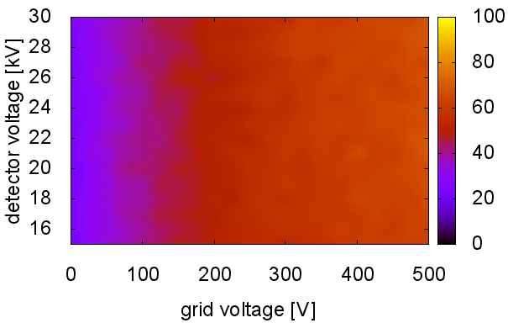
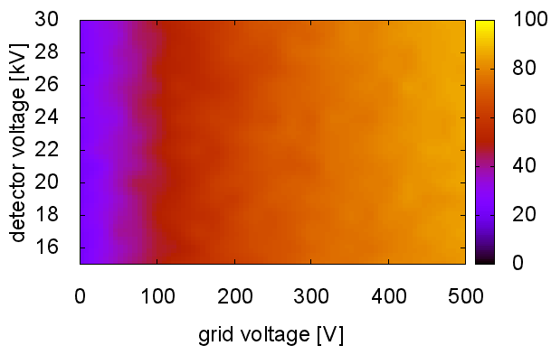
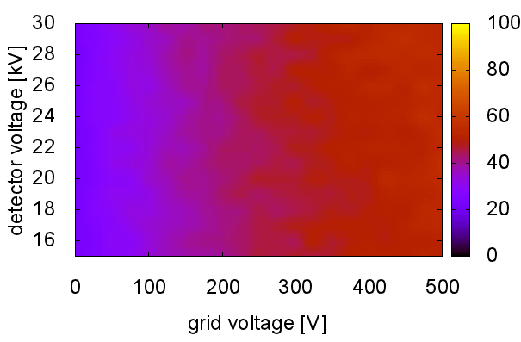
$$Ψ=0°$$
$$Ψ=45°$$
$$Ψ=30°$$
$$Ψ=60°$$

Slide 9
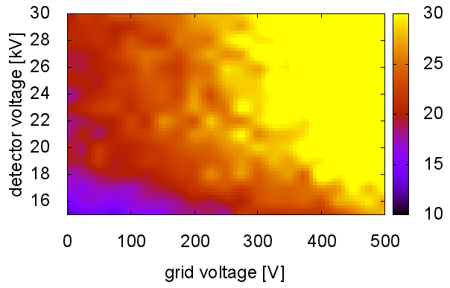
Results
$Ψ=0°$
K.E. = 370 eV,
FWHM=40 eV

Slide 10
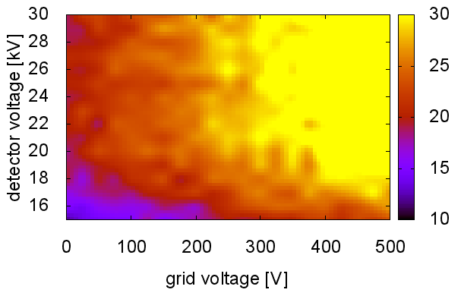
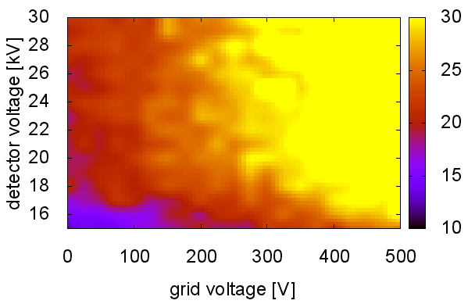
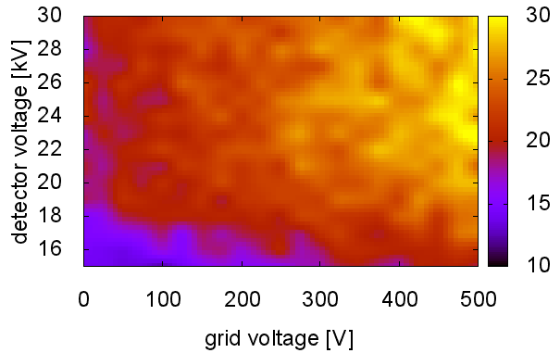
$$Ψ=0°$$
$$Ψ=45°$$
$$Ψ=30°$$
$$Ψ=60°$$

Slide 11
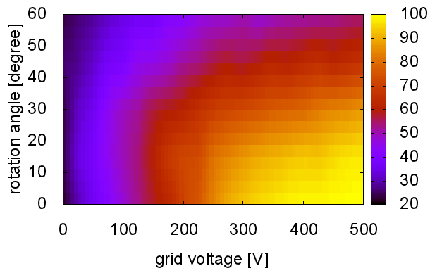
Results
K.E. = 370 eV,
FWHM=40 eV
$V_{detector}=25 kV$

Slide 12
Conclusions
25 gv 15000 dv
450 gv 26000 dv
Notes:
>300V, all $V_{detector}$ but higher is better for res.
Why we have to choose these parameters?

Slide 13
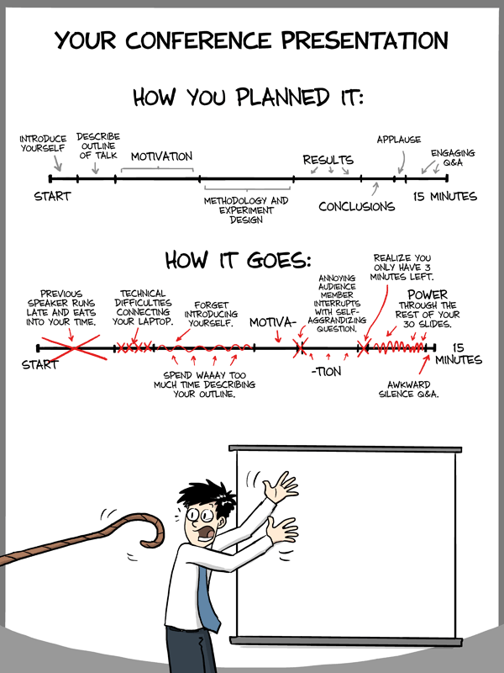
Thanks for your patience!
Do you have any questions?

Slide 14
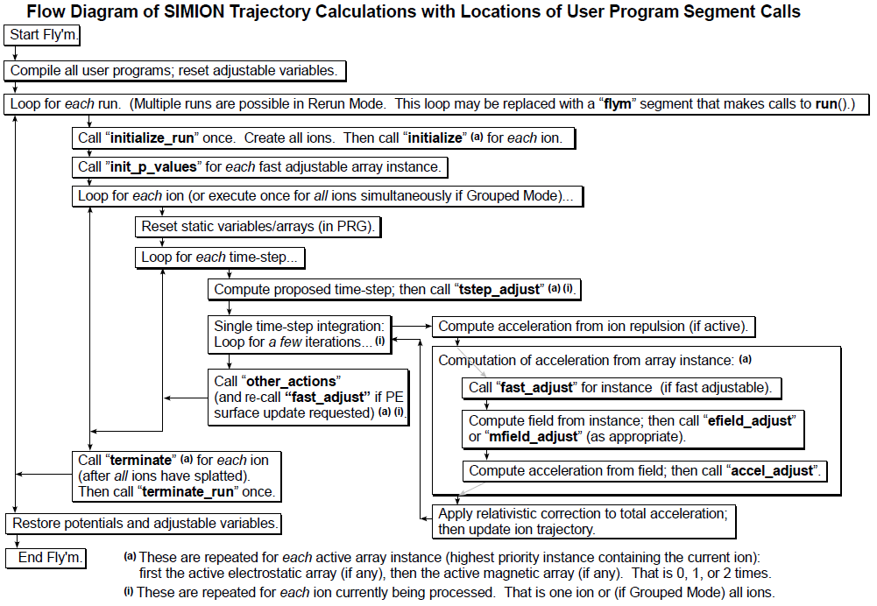
Material and Methods
Notes:
What parameters defined where and used for why?

