Slide 1












CPOTS – 3rd ERASMUS Intensive Program
Introduction to Charged Particle Optics: Theory and Simulation
UCM
http://cpots2013.physics.uoc.gr
Dept. of Physics, University of Crete
Aug 15 – 30, 2013
Heraklion, Crete, GREECE
CPOTS 2013: 3rd ERASMUS IP on Charge Particle Optics – Theory and Simulation
Dept. of Physics, University of Crete, Heraklion, GREECE
Project Coordinator: Prof. Theo Zouros (tzouros@physics.uoc.gr)

Slide 2

Project 6
5 Element Lens
Tobias Bauer¹, Anastasios Kanellakopoulos²,
Tuğçe Nur Tandırcıoğlu³
Supervisors: Genoveva Martínez López⁴, Pilar Garcés⁴
¹ Johann Wolfgang Goethe-Universität Frankfurt am Main
² National Kapodistrian University of Athens
³ Selçuk University
⁴Complutense University of Madrid

Slide 3
Motivation and Goals
Motivation
  Design an afocal lens
  Study the afocal properties of the 5 element lens
Goals
  Find the optimal voltage element combination
  Create the best possible beam for HDA entry

Slide 4
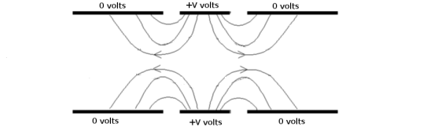
5 element lens
What is a 5 element lens?
A 5 element lens is just two 3 element lenses back to back attached!

Slide 5
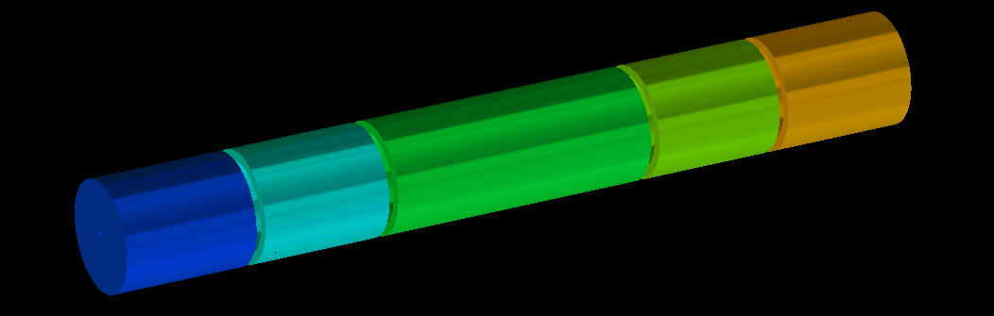
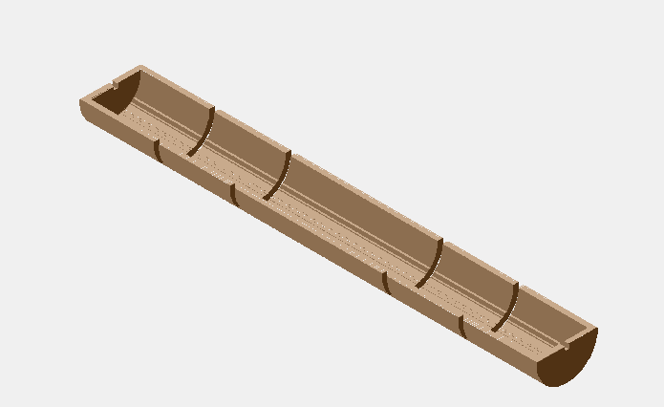
Geometry
Heddle’s Lens

Slide 6
Afocal Mode
Since the two lenses are identical the electrode voltages must fulfill the relationships:
and the transverse magnification is:

Slide 7
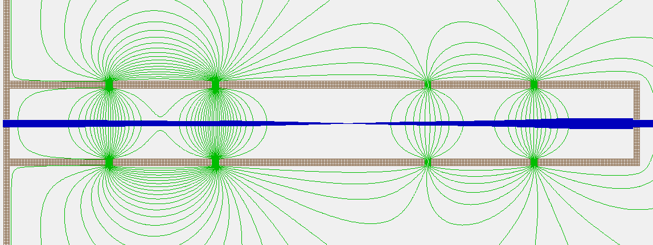
Afocal Lens
Afocal lens
  No focus points
  Beam doesn’t converge or diverge
  e.g. Beam that enters parallel, exits parallel

Slide 8
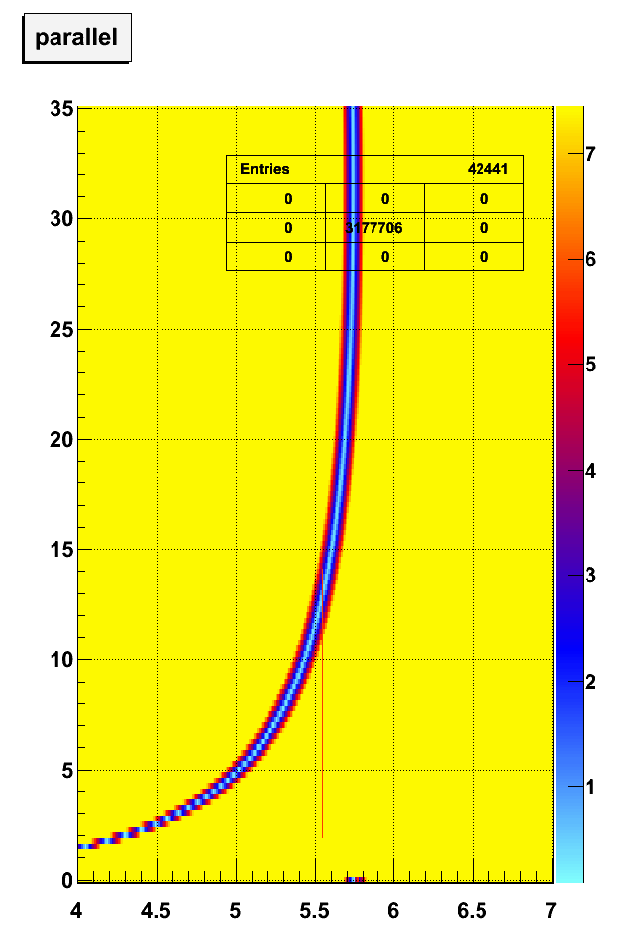
Afocal Lens Result
Output Angle
V₅/V₁ | V₂/V₁ | V₃/V₁ | V₄/V₁ | M_{exp} | |M_{th}| | α
0.25 | 2.436 | 0.50 | 1.218 | -1.411 | 1.414 | 0.194
0.5 | 3.055 | 0.707 | 2.161 | -1.188 | 1.189 | 0.165
1.0 | 3.691 | 1.000 | 3.691 | -0.998 | 1.000 | 0.142
5.0 | 4.900 | 2.236 | 10.957 | -0.678 | 0.669 | 0.001
10.5 | 5.450 | 3.240 | 17.660 | -0.557 | 0.556 | 0.001
10.5 | 0.559 | 3.240 | 1.811 | -0.568 | 0.556 | 0.002
24.0 | 5.820 | 4.899 | 28.512 | -0.446 | 0.451 | 0.001
24.0 | 0.81 | 4.899 | 3.968 | -0.463 | 0.451 | 0.001
V₅/V₁ | V₂/V₁ | V₃/V₁ | V₄/V₁ | M_{exp} | |M_{th}| | α
0.25 | 2.436 | 0.50 | 1.218 | -1.411 | 1.414 | 0.194
0.5 | 3.055 | 0.707 | 2.161 | -1.188 | 1.189 | 0.165
1.0 | 3.691 | 1.000 | 3.691 | -0.998 | 1.000 | 0.142
5.0 | 4.900 | 2.236 | 10.957 | -0.678 | 0.669 | 0.001
10.5 | 5.450 | 3.240 | 17.660 | -0.557 | 0.556 | 0.001
10.5 | 0.559 | 3.240 | 1.811 | -0.568 | 0.556 | 0.002
24.0 | 5.820 | 4.899 | 28.512 | -0.446 | 0.451 | 0.001
24.0 | 0.81 | 4.899 | 3.968 | -0.463 | 0.451 | 0.001
V₄
V₂

Slide 9
Aberrations
Aberrations
  Spherical
  Coma

Slide 10
Spherical Aberattion
V₅ | R₁ | R_{1.5} | R₂ | R_{2.5} | R₃
0.25 | 0.010 | 0.023 | 0.049 | 0.088 | 0.145
0.50 | 0.011 | 0.023 | 0.040 | 0.064 | 0.102
1.0 | 0.008 | 0.016 | 0.028 | 0.042 | 0.066
5.0 | 0.016 | 0.021 | 0.024 | 0.023 | 0.017
10.5 | 0.001 | 0.002 | 0.006 | 0.013 | 0.025
10.5 | 0.028 | 0.045 | 0.065 | 0.090 | 0.121
24.0 | 0.008 | 0.013 | 0.021 | 0.029 | 0.041
24.0 | 0.021 | 0.034 | 0.049 | 0.067 | 0.090
V₅ | R₁ | R_{1.5} | R₂ | R_{2.5} | R₃
0.25 | 0.010 | 0.023 | 0.049 | 0.088 | 0.145
0.50 | 0.011 | 0.023 | 0.040 | 0.064 | 0.102
1.0 | 0.008 | 0.016 | 0.028 | 0.042 | 0.066
5.0 | 0.016 | 0.021 | 0.024 | 0.023 | 0.017
10.5 | 0.001 | 0.002 | 0.006 | 0.013 | 0.025
10.5 | 0.028 | 0.045 | 0.065 | 0.090 | 0.121
24.0 | 0.008 | 0.013 | 0.021 | 0.029 | 0.041
24.0 | 0.021 | 0.034 | 0.049 | 0.067 | 0.090

Slide 11
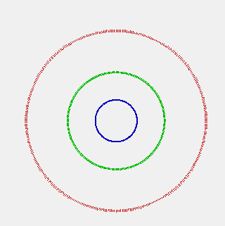
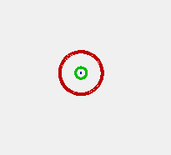
Spherical Aberration
Ke = 1eV, Plane X = 120mm (exit)
V₅ = 10.5 Volts, V2 = 5.450 Volts
V₅ = 10.5 Volts, V2 = 0.559 Volts
R = 0.121 mm
R = 0.025 mm
1°
Initial
angle
2°
3°

Slide 13
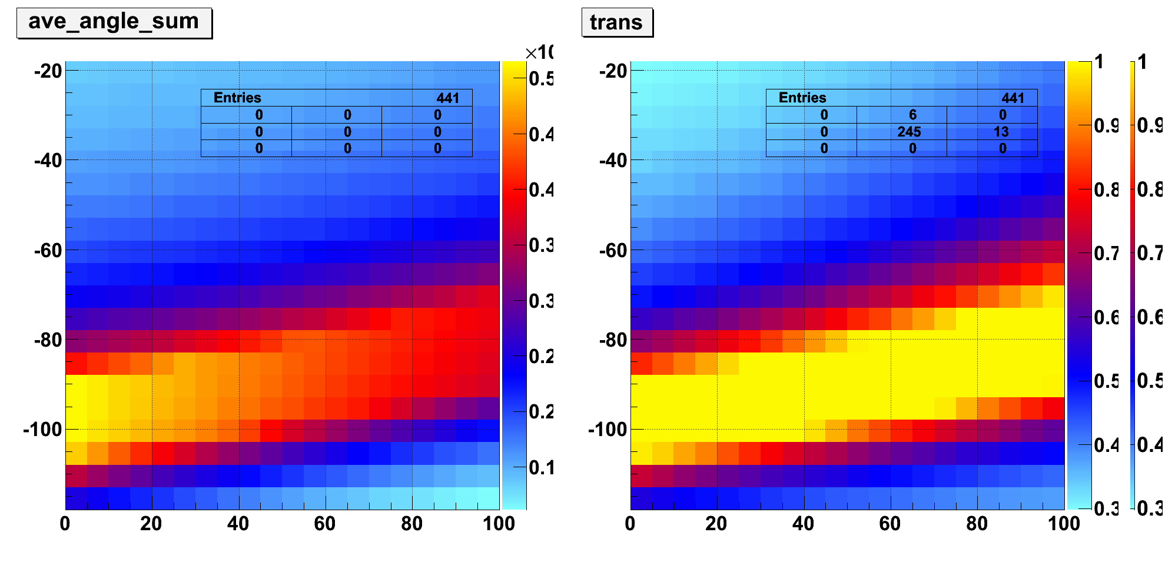
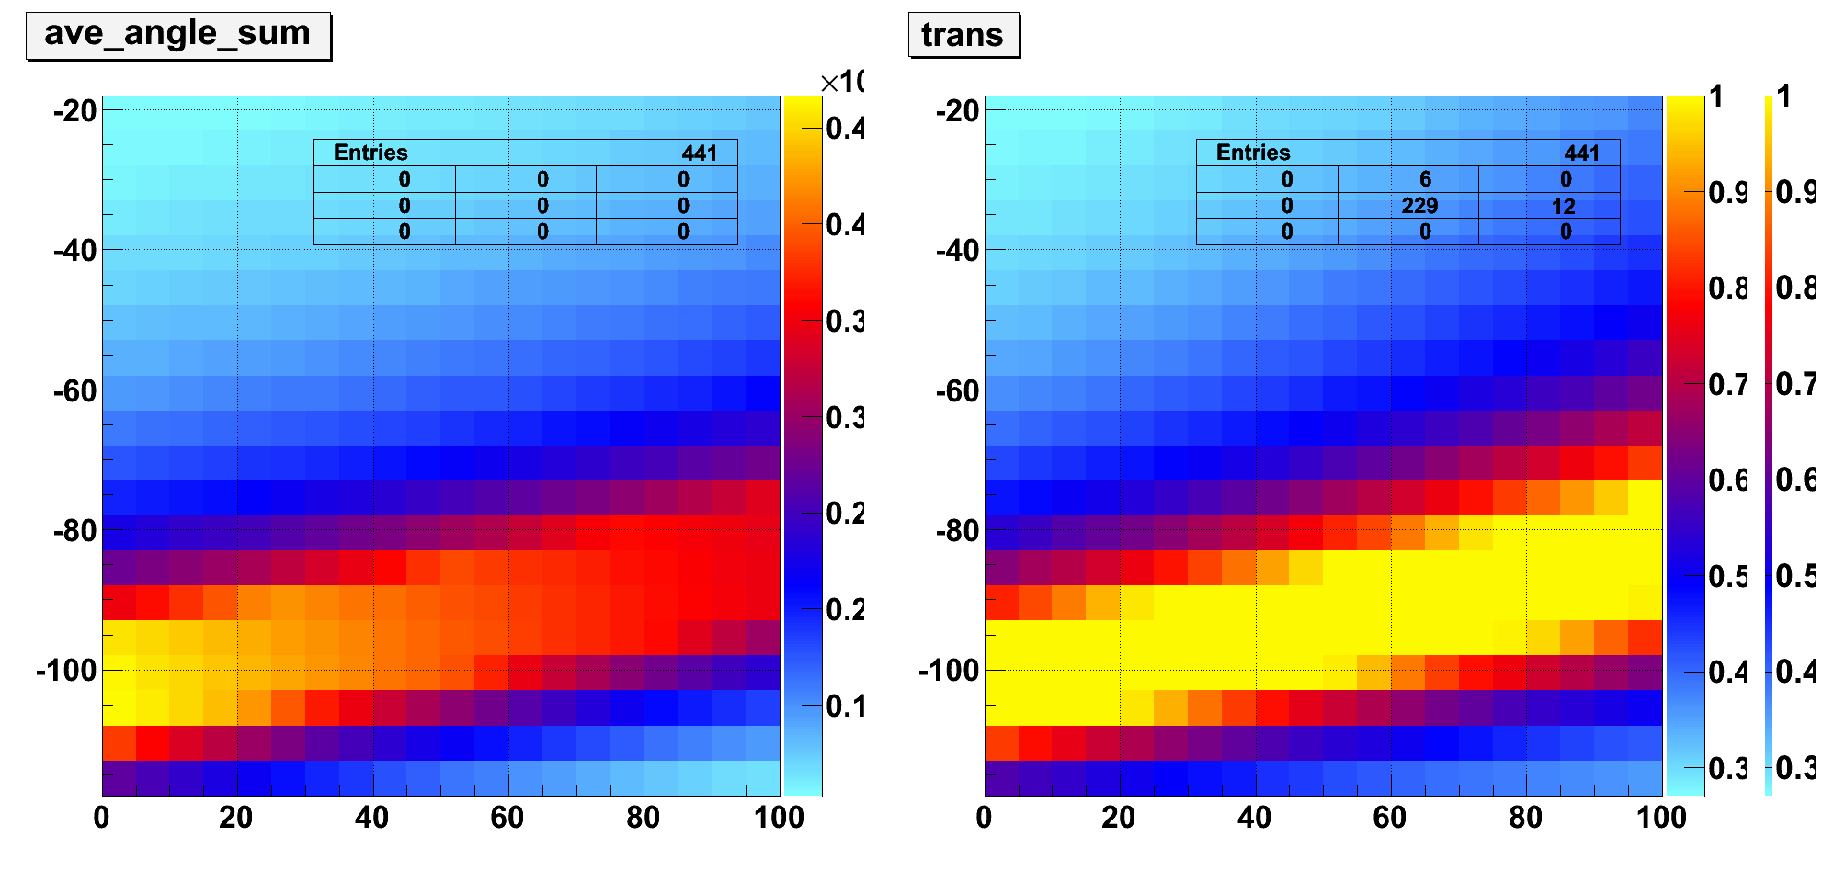
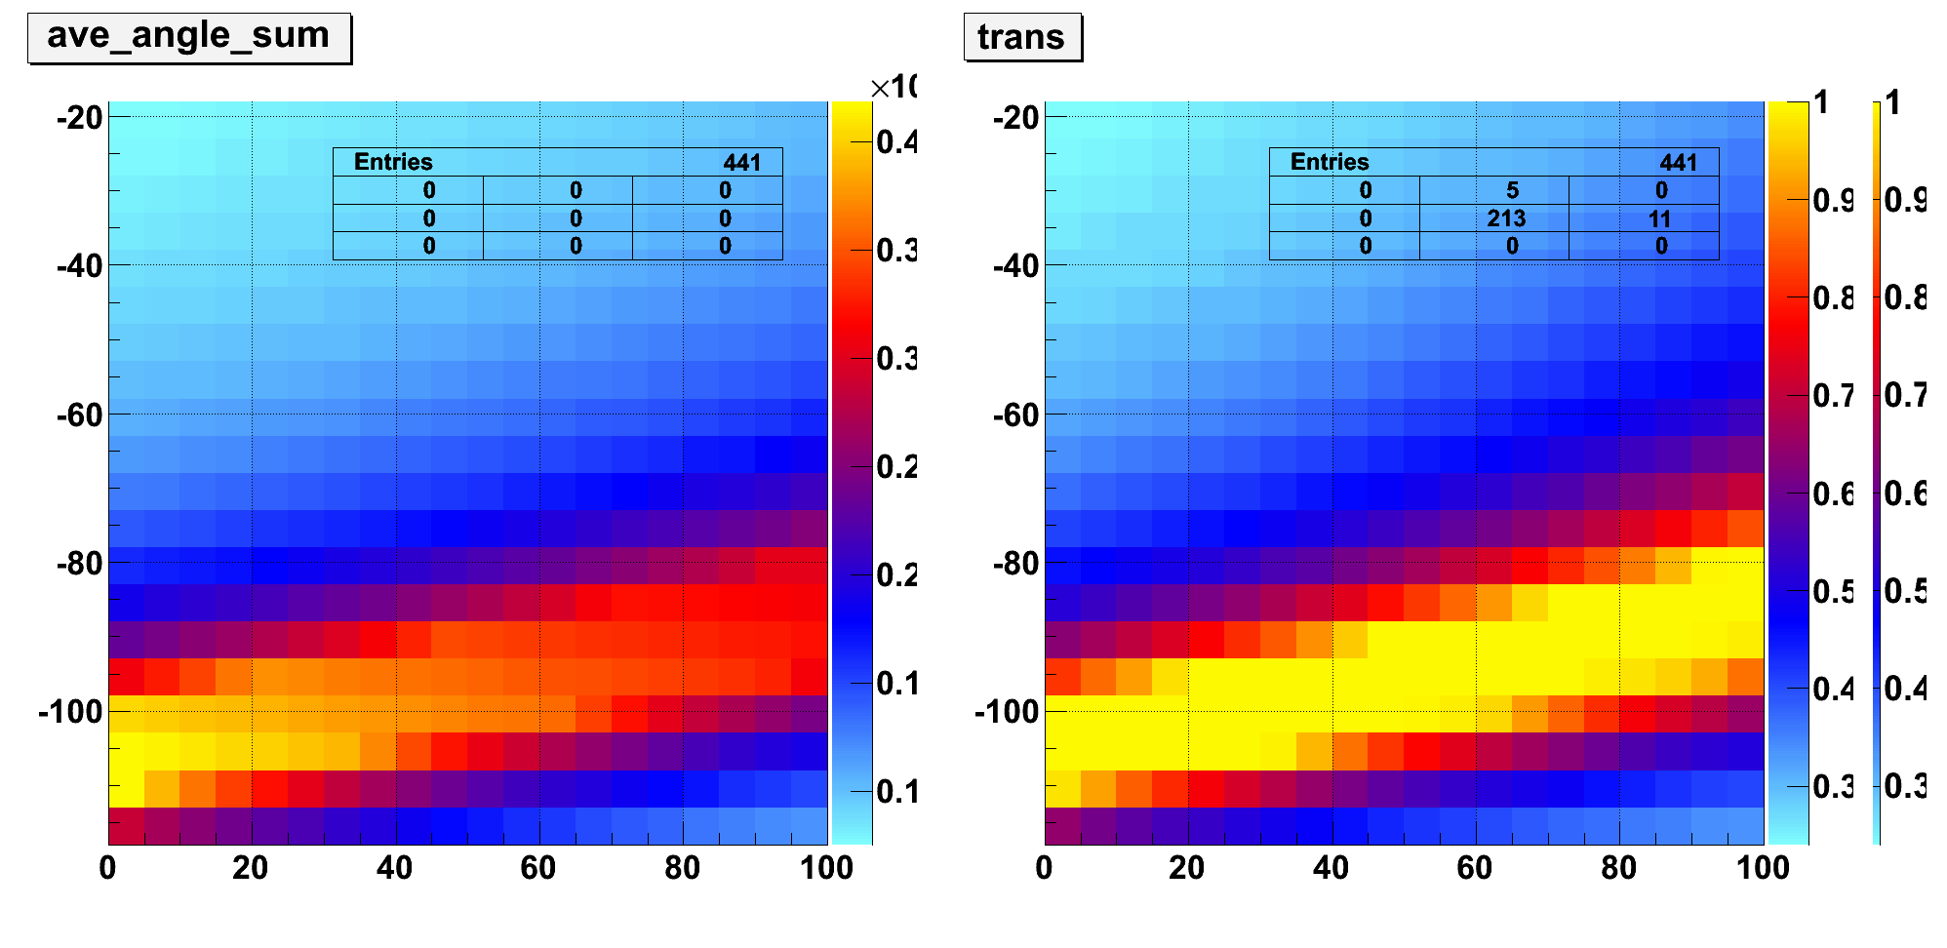
Optimisation
V₄ = 40V
Output Angle
Transmission
V₄ = 20V
V₄ = 0V
V₃
Better Parallel Alignement
keeping the same transmission
V₂

Slide 14
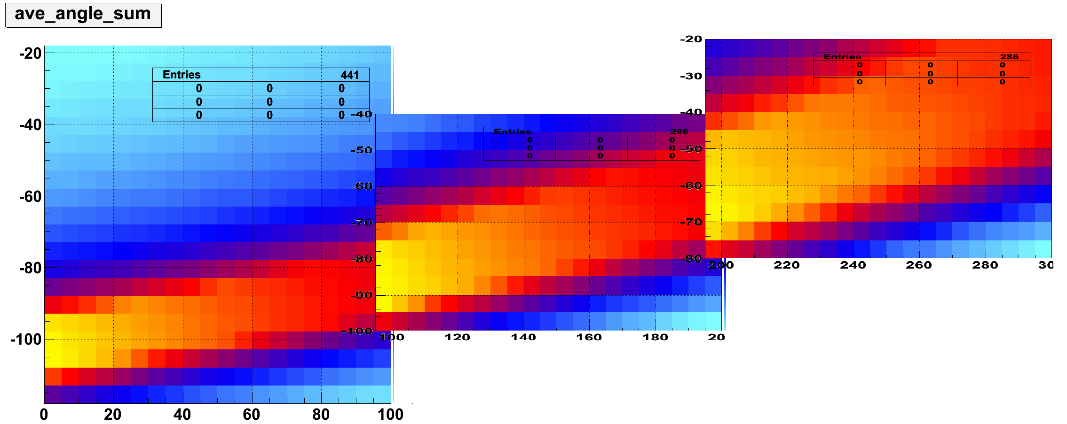
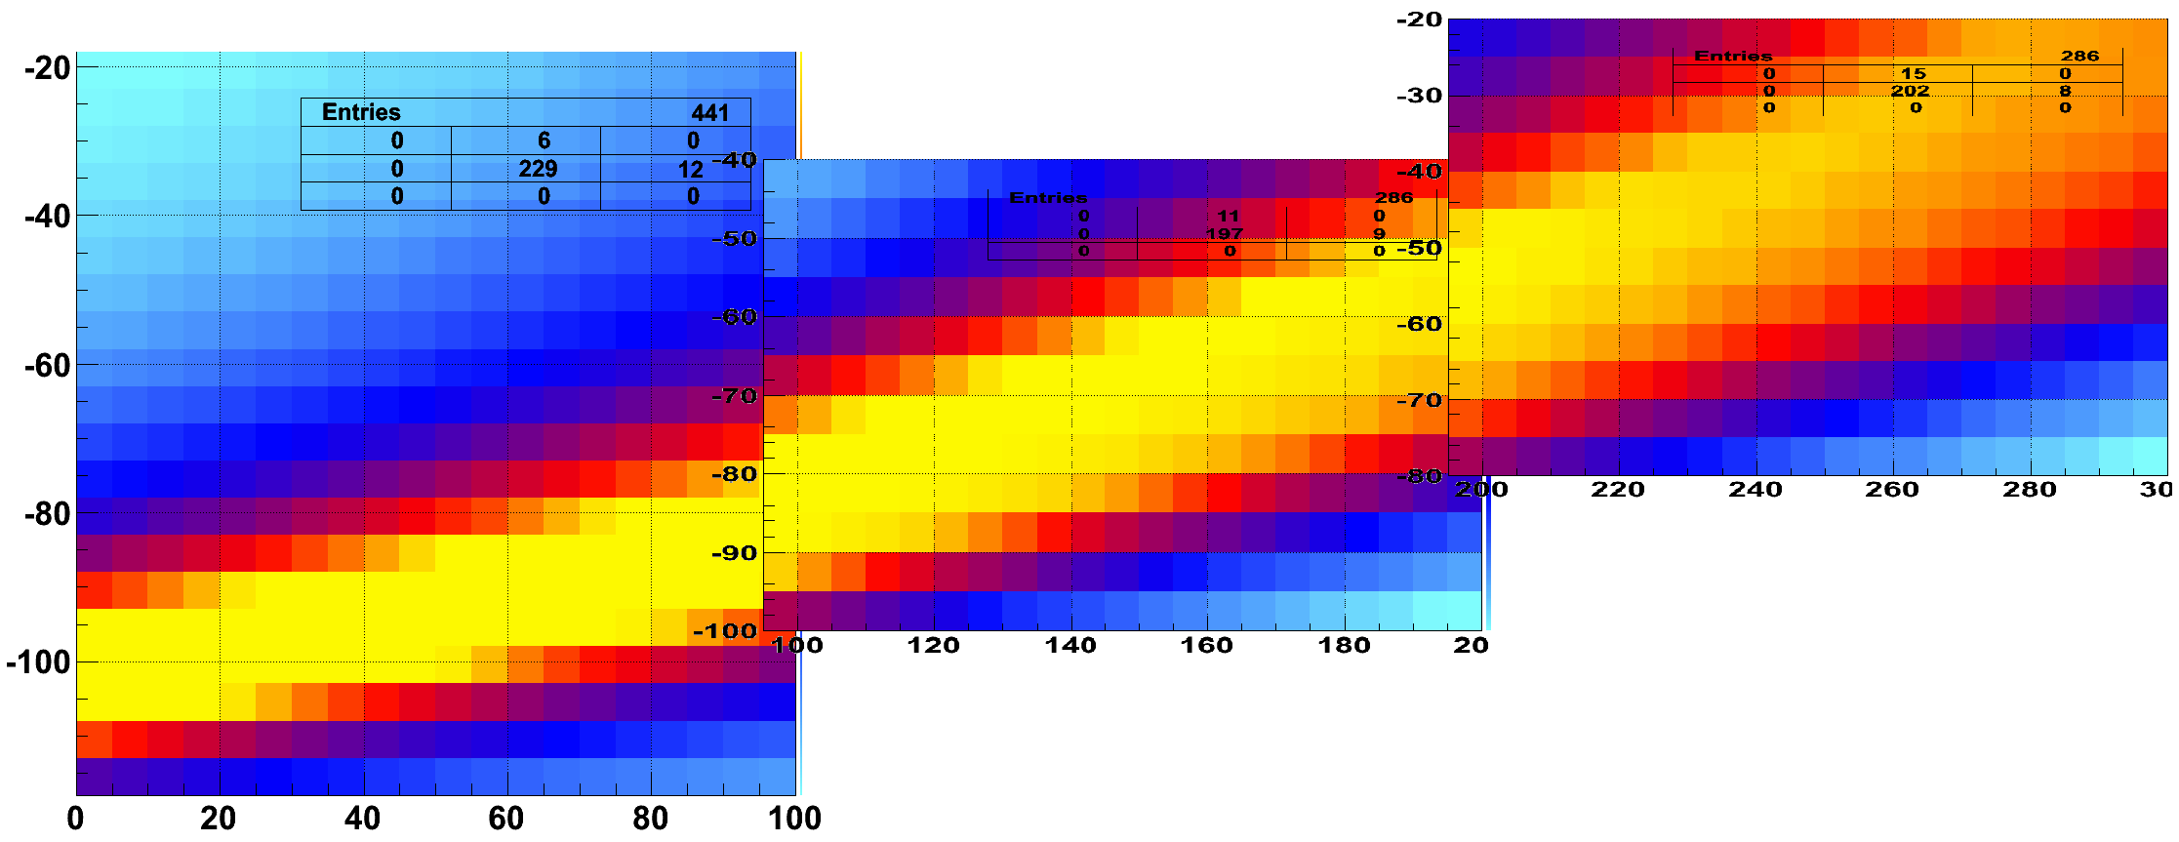
Following Traces
Ave Angle Sum
V₂
V₃
100% Transmission with smallest angle sum
V2 = 205V, V3 = -50, V4 = 40V*
Transmission
*currently not optimized

Slide 15
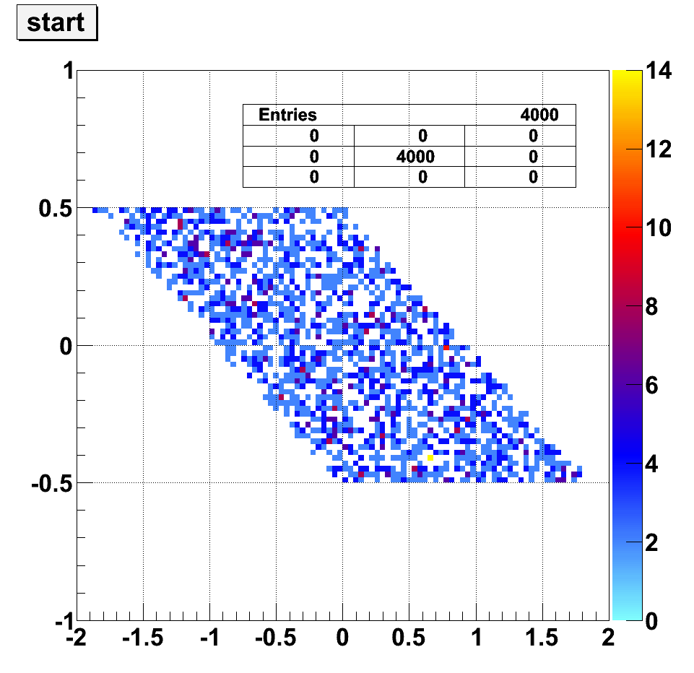
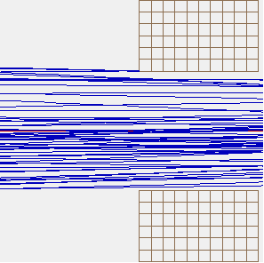
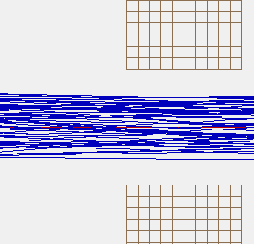
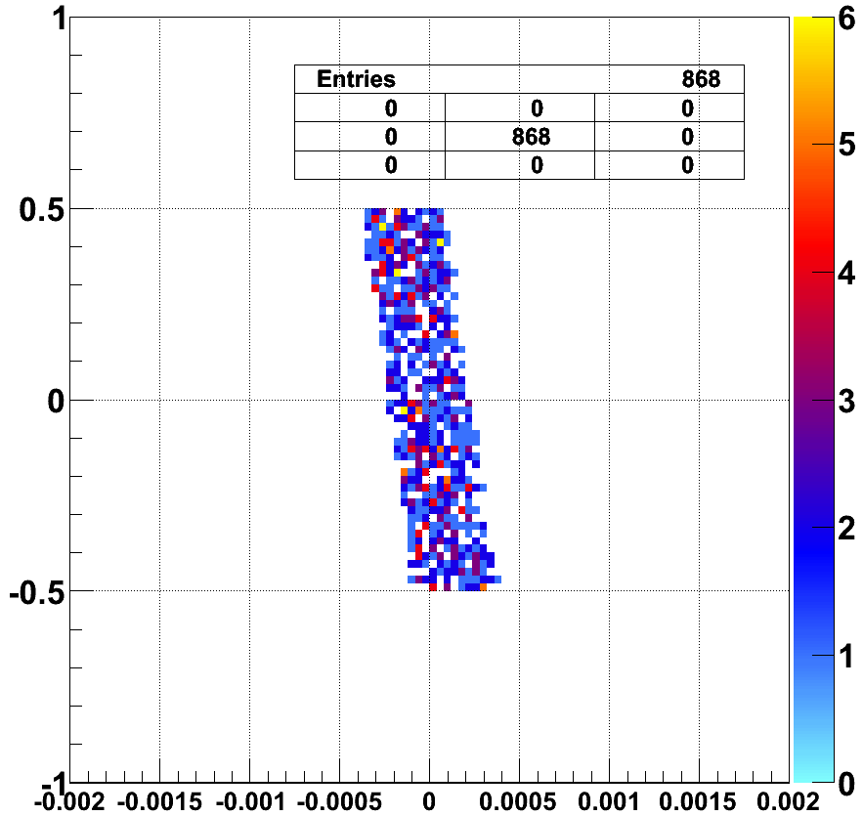
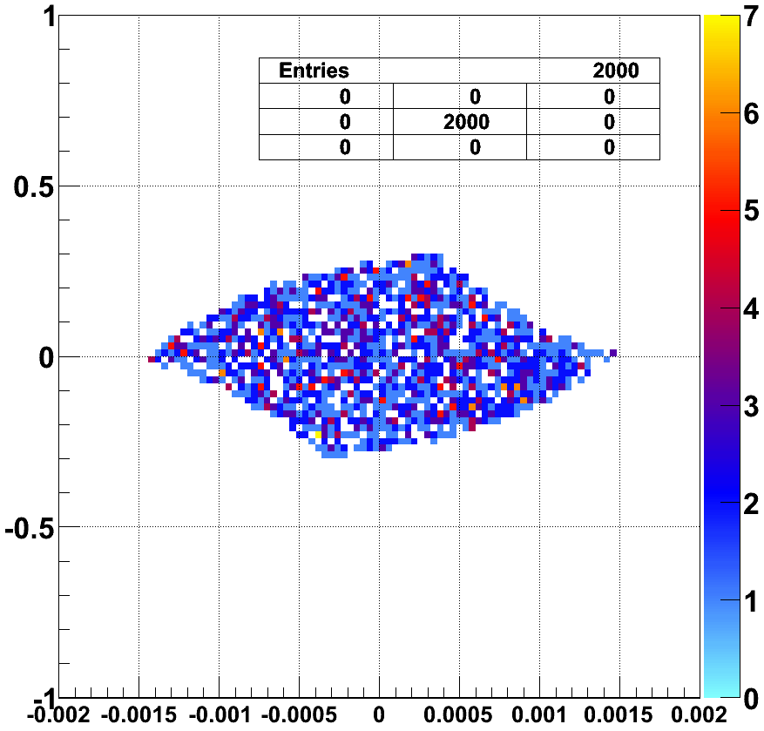
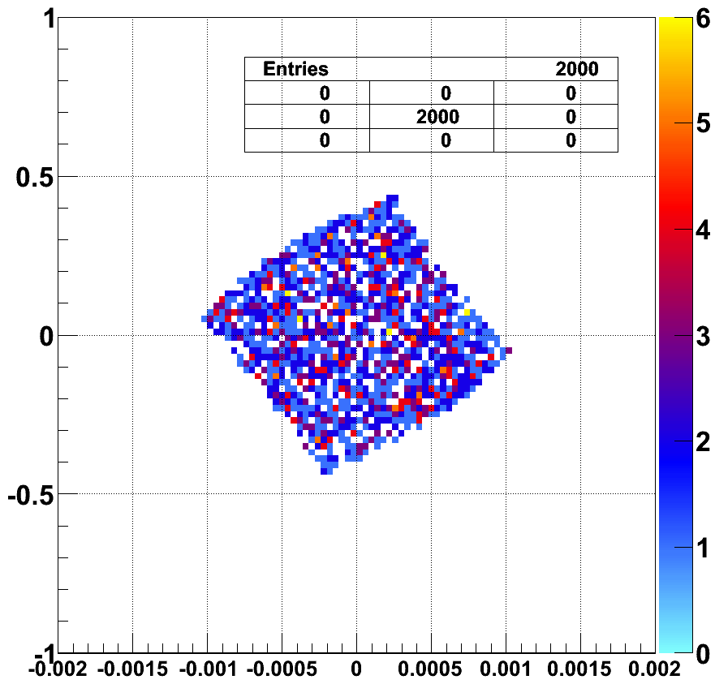
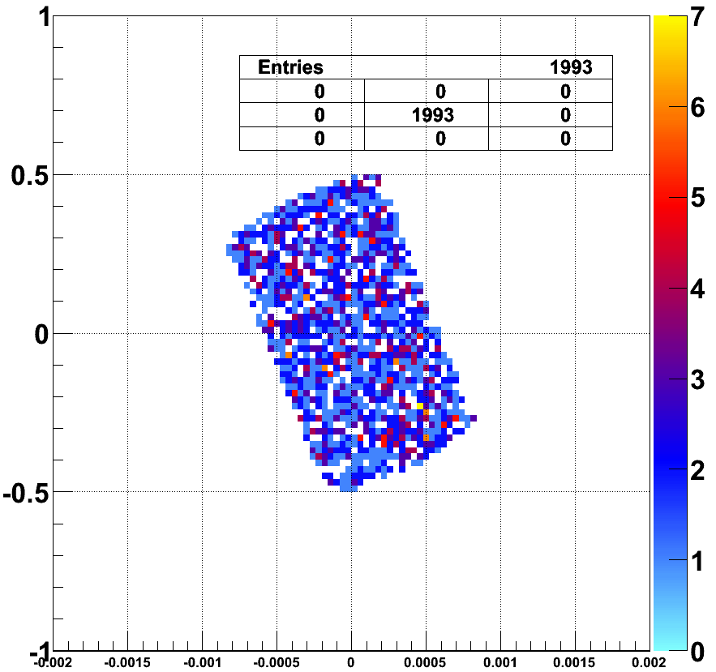
Following Traces - Results
going to < 50% Transmission
Transmission
V2 = 0, V3 = -100, V4 = 40
V2 = 110, V3 = -80, V4 = 40
V2 = 205, V3 = -50, V4 = 40

Slide 16

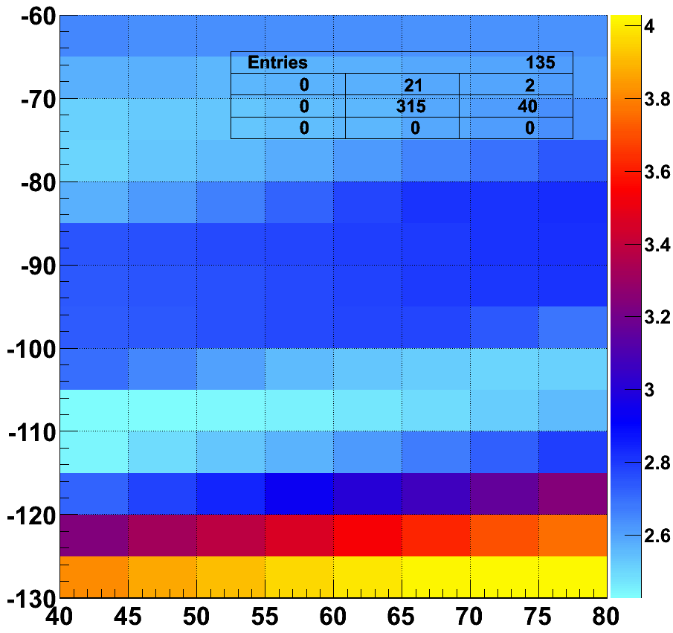
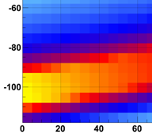
How to continue…
Score =
3 * Best_Angle / Ave_Angle
+ 1 * Transmission
Introduce new Score value to minimize
Example:
Score =W1 * Transmission + W2 * Parallel_Angle_Sum + W3 * Fokus_Width + …
V₃
V₂
V₃
Trans
V₃
V₂
V₂

Slide 17
The end
Thank you for your attention
Any questions?

