Slide 1




The Biased Paracentric Hemispherical Deflector Analyzer
Nick Angelinos¹ , Suay Kazgöz ², Thanassis Psaltis ³
¹ Department of Physics, University of Crete,71003 Heraklion, Crete, Greece
² Department of Physics, Science and Arts Faculty, Afyon Kocatepe University, 03200
Afyonkarahisar, Turkey
³ Department of Physics, University of Athens, Panepistimiopolis, Zografos 157 84, Athens, Greece

Slide 2
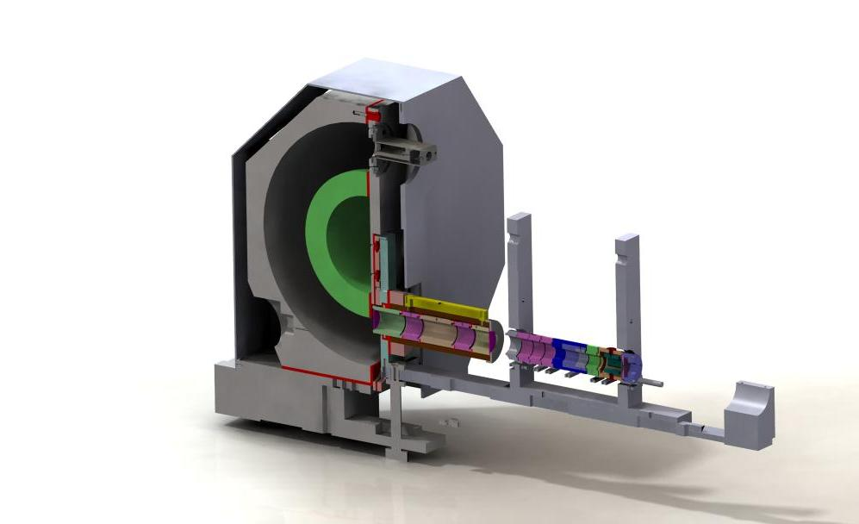
Introduction
Experimental and theoritical studies presented that better resolution is applicaple by 180⁰ hemispherical deflector analyzers. High resolution is obtained by the dispersion property of the analyzer i.e. by separation of two electrons according to their energies.
The hemispherical deﬂector analyzer (HDA) is one of the most widely used electrostatic energy selectors in low energy atomic collision physics.
An Hemispherical Deflector Energy Analyser consists of 3 parts.
Input Lens System
Hemispherical Deflection Analyser
CEM (Chanel Electron Multiplier)

Slide 3
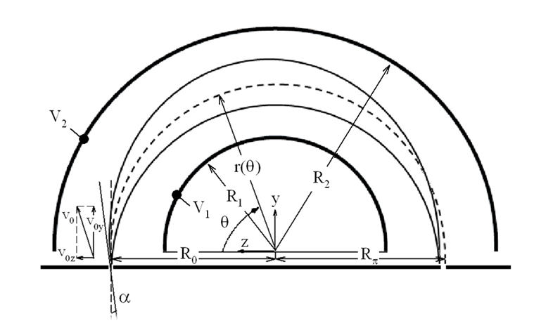
Motivation and Goal
Study the focusing properties of the biased paracentric HDA in comparison to the conventional HDA.
Build an HDA with mean Radius = 150 mm and ΔR = 50 mm ¹. Find the special paracentric positions and optimal bias. Compare both positive and negative bias paracentric entries.
¹ ΔR= R2-R1

Slide 4
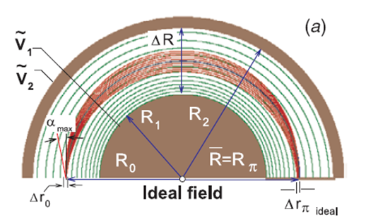
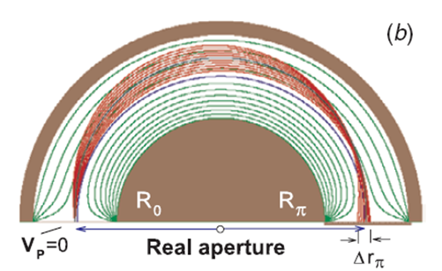
Ideal vs Real HDA
Ideal HDA
1st order focusing in ideal 1/r² E field
(semicircular equipotentials)
No fringing fields! Analytical solution valid.
Real HDA
In deflectors the ideal field is necessarily modified by the aperture producing fringing fields near the plate. Analytical Solution not valid! Must use simulations (SIMION)

Slide 5
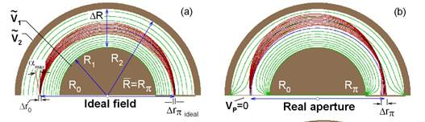
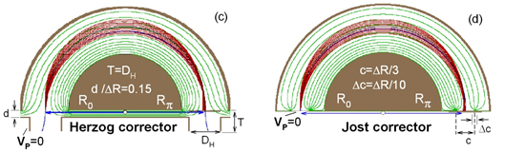
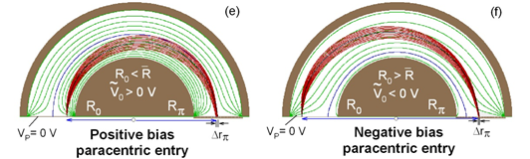
Proposed Solutions

Slide 6
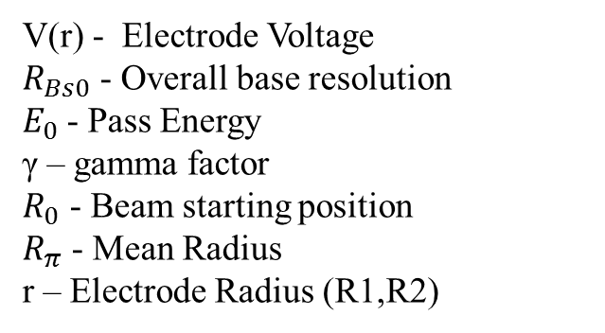
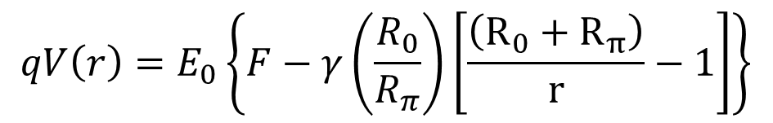
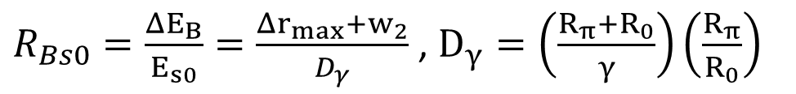
Electron Optical Properties
$$qV\left(r\right)=E_{0}\left\{F−γ\left(\frac{R_{0}}{R_{π}}\right)\left[\frac{\left(R_{0}+R_{π}\right)}{r}−1\right]\right\}$$
V(r) - Electrode Voltage
$R_{Bs0}$ - Overall base resolution
$E_{0}$- Pass Energy
γ – gamma factor
$R_{0}$ - Beam starting position
$R_{π}$ - Mean Radius
r – Electrode Radius (R1,R2)
$R_{Bs0}=\frac{ΔE_{B}}{E_{s0}}=\frac{Δr_{max}+w_{2}}{D_{γ}}$ , $D_{γ}=\left(\frac{R_{π}+R_{0}}{γ}\right)\left(\frac{R_{π}}{R_{0}}\right)$

Slide 7
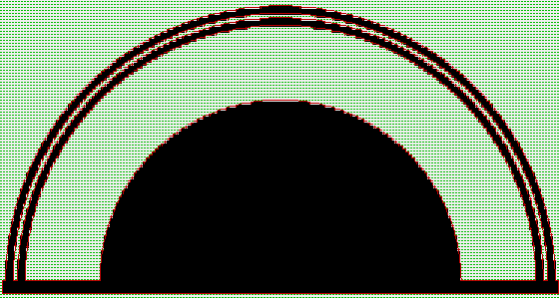
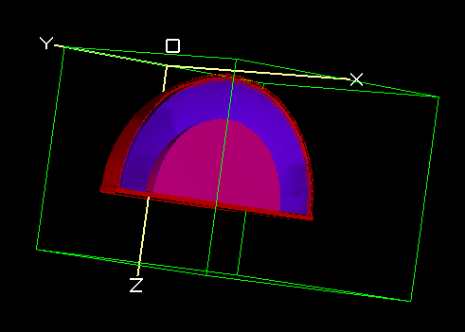
Our Solution
We built an HDA with mean Radius = 150 mm and ΔR = 50 mm .
ΔR
R2
R1
SIMION XZ View
SIMION 3D View

Slide 8

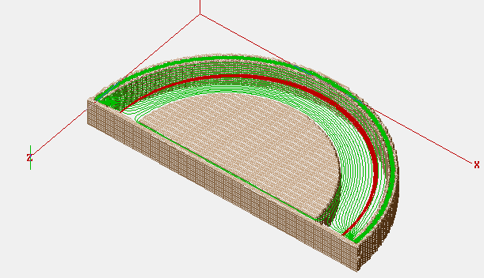
Our Solution
function segment.flym()
sim_trajectory_image_control = 1
file= io.open("data.dat","w")
for gamma=.5,1.9,.5 do
for R0= -R2+3,-R1-3, dx_step do
start_pos=R0
V1=-energy*(1-gamma*(-start_pos/R_mean)*((-start_pos+R_mean)/R1-1))
V2=-energy*(1-gamma*(-start_pos/R_mean)*((-start_pos+R_mean)/R2-1))
run()
end
file:close()
end
end
We created a Lua routine, which changes both the starting position of the beam and the electrodes’ voltages, calculates the width of the beam after it splats, and the energy resolution.

Slide 9
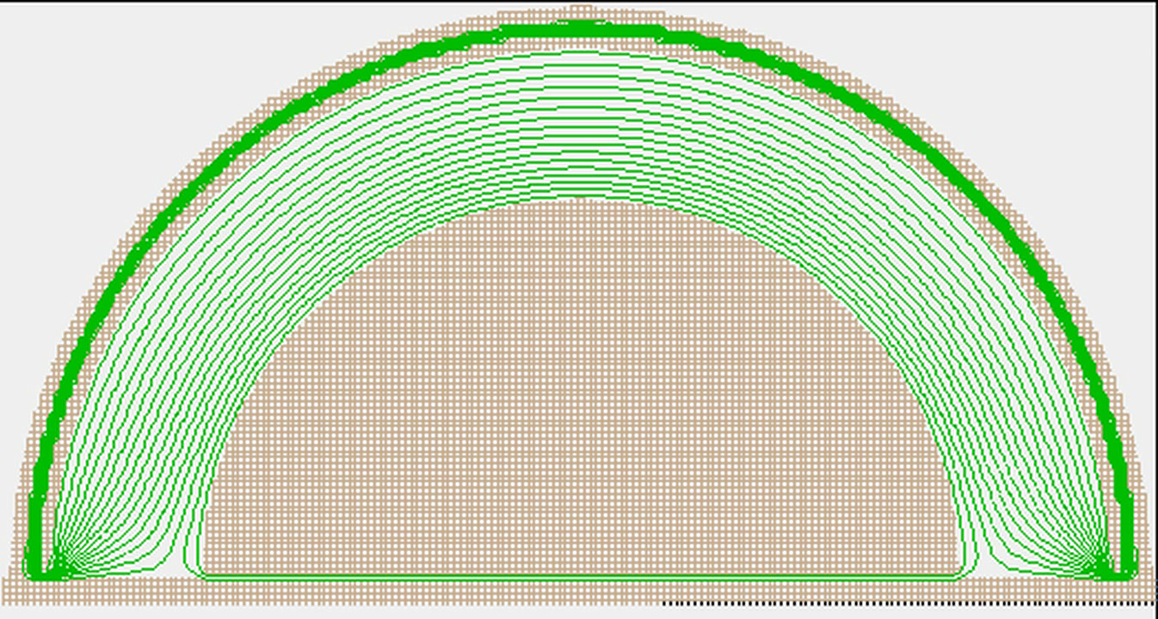
The Simulation

Slide 10
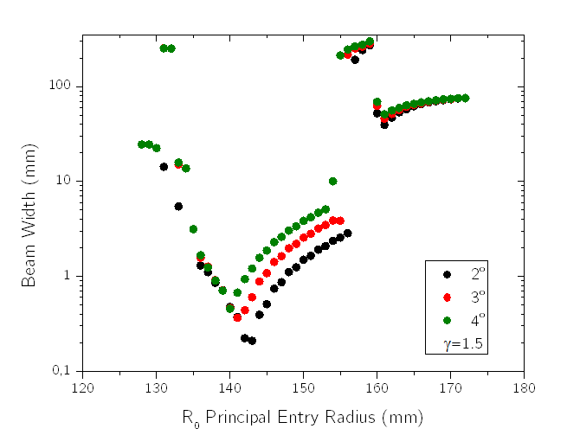
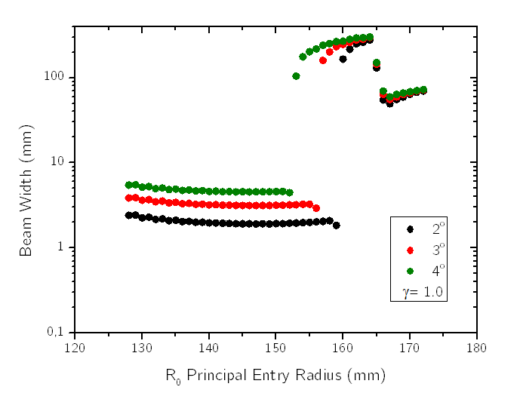
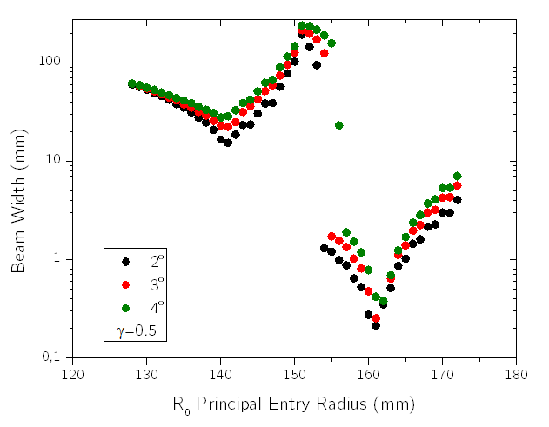
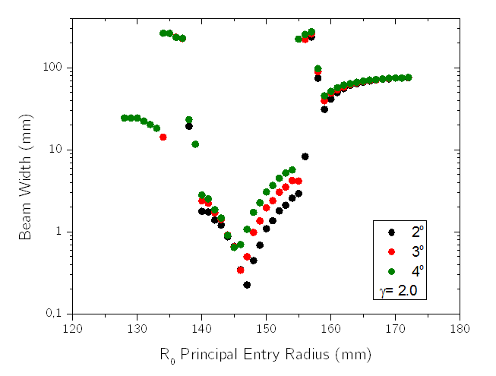
Results
ΔR=0.20 mm
ΔR=0.22 mm
ΔR= 0.21 mm
We reached the minimum beam width of: Δr= 0.20, γ=1.5 and R_{o}=143 mm

Slide 11
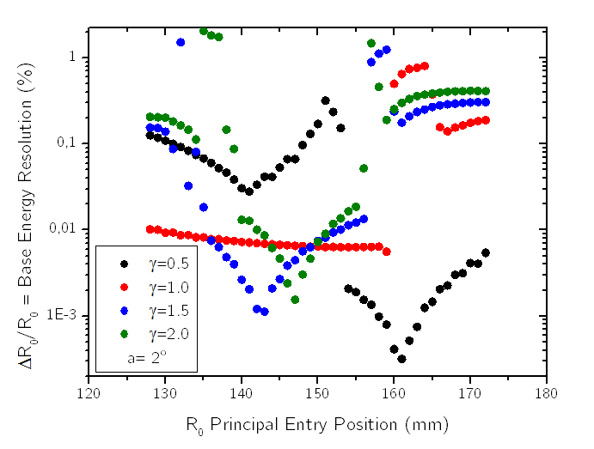
Results

Slide 12
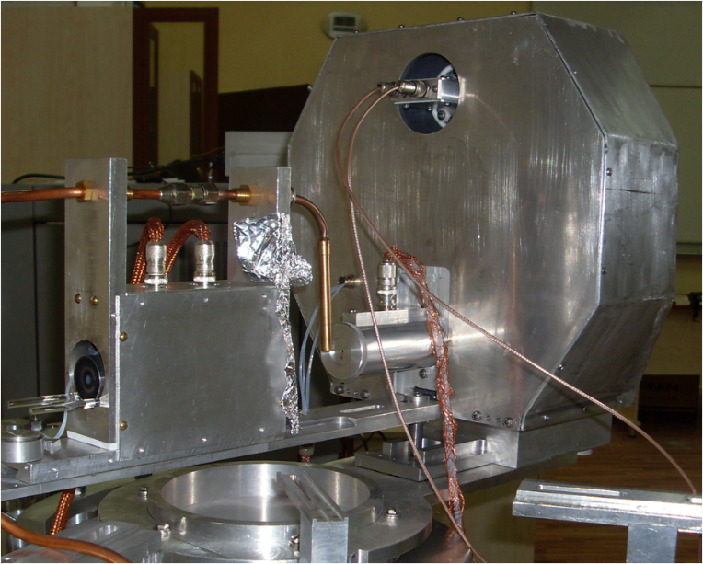
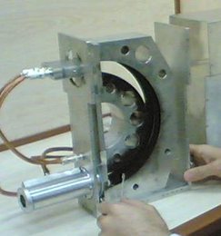
Conclusion
The Lua script we wrote, can be used in any HDA with given R1, R2. (Useful tool for researchers)
Our results are compatible with theory and the bibliographic values.
HDA and e-gun from Afyon Kocatepe University

Slide 13
References
T J M Zouros, Omer Sise, Melike Ulu and Mevlut Dogan, Meas. Sci. Technol. 17 (2006) N81–N86
M. Dogan, M. Ulu, G. G. Gennarakis, and T. J. M. Zouros, Rev. Sci. Instrum. 84, 043105 (2013) http://dx.doi.org/10.1063/1.4798592
Roberto Ierusalimschy, Programming in Lua, 2nd edition
David Manura, SIMION 8.0 user manual

Slide 14
Acknowledgements
We would like to thank Prof. Theo Zouros for helping us through the process of creating the project. We are also thankful to Pilar Garcés for her assistance and patience. Finally we would like to thank Dr. Zehra Nur Özer, Tassos Kanellakopoulos, Izabella Floss and Valerie Smejkal for their help.

Slide 15
The end!
Thank you for your attention!
Any questions?

